Slide 1


Department of Computer Science and Engineering
DIABETIC RETINOPATHY DETECTION
K.SOWMIYA / 211419104261
B.ANDHI / 211419104011
E.THARANI EMMANUEL / 211419104326
GUIDE NAME
Mrs. M. Maheswari M.Tech
COORDINATOR NAME
Dr K Valarmathi ME.,PhD

Slide 2
INTRODUCTION
Diabetic retinopathy is a disease caused by uncontrolled chronic diabetes and it can cause complete BLINDNESS if not timely treated
Therefore, early medical diagnosis of diabetic retinopathy and providing better medical cure is essential to prevent the severe side effects of diabetic retinopathy.
Diabetes mellitus or imply diabetes is a disease caused due to the increase in LEVEL OF BLOOD GLUCOSE.
Diabetic Retinopathy is one such disease of retina which occurs in people suffering from long standing diabetes

Slide 3
OBJECTIVE OF THE PROJECT
The aim of this project is to develop a system which can perform early prediction of diabetes for a patient with a higher accuracy
Around 80 percent of population having diabetes for more than 10 or more years has some stage of the disease.
Almost two‑third of all Type 2 and almost all Type 1 diabetics are expected to develop DR over a period of time.
The automated system will grade the images on the level of severity

Slide 4
LITERATURE SURVEY
2023 | Internet of things and deep learning enabled diabetic retinopathy diagnosis using rfi | 1.Thangam palaniswamy 2.mahendran vellingiri | It's execute region growing on four adjacent pixels and add all they aren't include before in region and save the new pixela | ability to execIts ute features engineering by itself faster learning | It is difficult image acquisition and limited user application
ADVANTAGE
DIS
ADVANTAGE
YEAR
TITLE
AUTHOR
DISCRIPTION

Slide 5
LITERATURE SURVEY
2022 | Graph adversial transfer learning for diabetic retinopathy classification | 1.Jingbottu 2.huan Wang 3.yelu | Train the model by designing 2classifier for adversarial purpose to improve robustness of model and improve classification performance model | Capable of doing task that convolution neural incapable of performing | Limited on fixed number of points and time space and time complexity is higher
YEAR
TITLE
AUTHOR
DISCRIPTION
ADVANTAGE
DIS
ADVANTAGE

Slide 6
LITERATURE SURVEY
2022 | Deep learning technique for diabetic retinopathy | Mohammad Z. Atwany | RFI images like drive,eyepacs,Aptos,stare,diaretdb,etc 9 sets are used for comparing Dr technique | It helps to reduce risk of vision loss for diabetic | Sometimes it will not give accurate result
DIS
ADVANTAGE
YEAR
TITLE
AUTHOR
DISCRIPTION
ADVANTAGE

Slide 7
PROBLEM STATEMENT
Diabetes effects the circulatory system of a person, including that of the retina, which leads to DR. The oxygen supply to the visual system is reduced to a huge extent and it causes swellings on the retinal vessels.
Also retinal lesions are formed which includes haemorrhages, microaneurysms and exudates. These are the symptoms for the disease, which will not be visible in the initial stages of the disease.
Therefore, unless the patient takes regular examination of the disease, it cannot be identified and thus not cured.

Slide 8
EXISTING SYSTEM
All the existing systems are concentrating on segmenting the primary anomalies responsible for initial stage of the disease.
There is no single approach or method for segmenting all the anomalies. Many classification techniques are proposed with different and novel approaches of pre- processing.
Many classification techniques are proposed with different and novel approaches of pre- processing.

Slide 9
PROPOSED SYSTEM
The Proposed system is a multistage classifier of Diabetic Retinopathy.
This system overcomes the drawbacks of the existing system by classifying the disease in to FIVE STAGES, namely, Normal, Mild, Moderate,Severe and Proliferactive .
This multistage classification is important because the disease itself progresses in multiple stages.

Slide 10
PROPOSED SYSTEM (Contd..)
The reoccurrence of the disease depends on the stage in which the treatment is provide, so it is not enough to classify the image as normal and abnormal
Existing system only segmented anomalies like microaneurysms, the problem with this is this anomaly
The proposed system overcomes this by segmenting haemorrhages along with microaneurysms

Slide 11
SOFTWARE / HARDWARE USED
SOFTWARE REQUIREMENTS
Tools : Anaconda IDE
Operating System : Window 7 and above
HARDWARE REQUIREMENTS
Processor : Intel Core
i5 Speed : 2.4GHz
RAM : 4 GB
Hard Disk : 20 GB

Slide 12
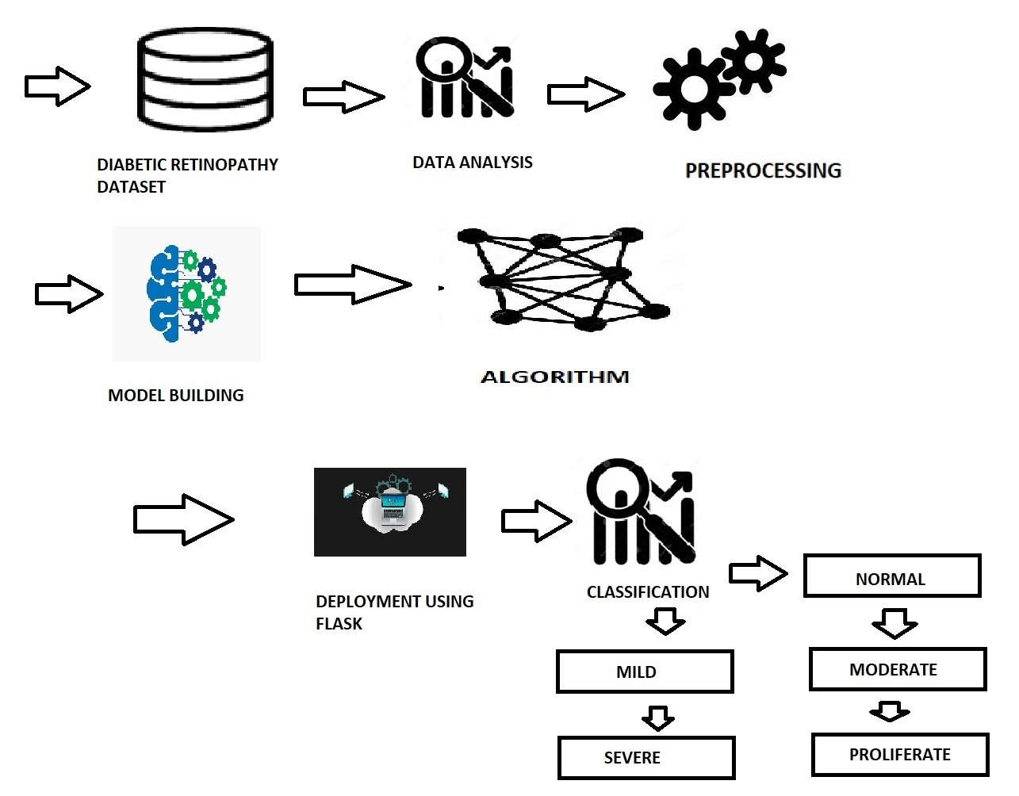
ARCHITECTURE DIAGRAM

Slide 13
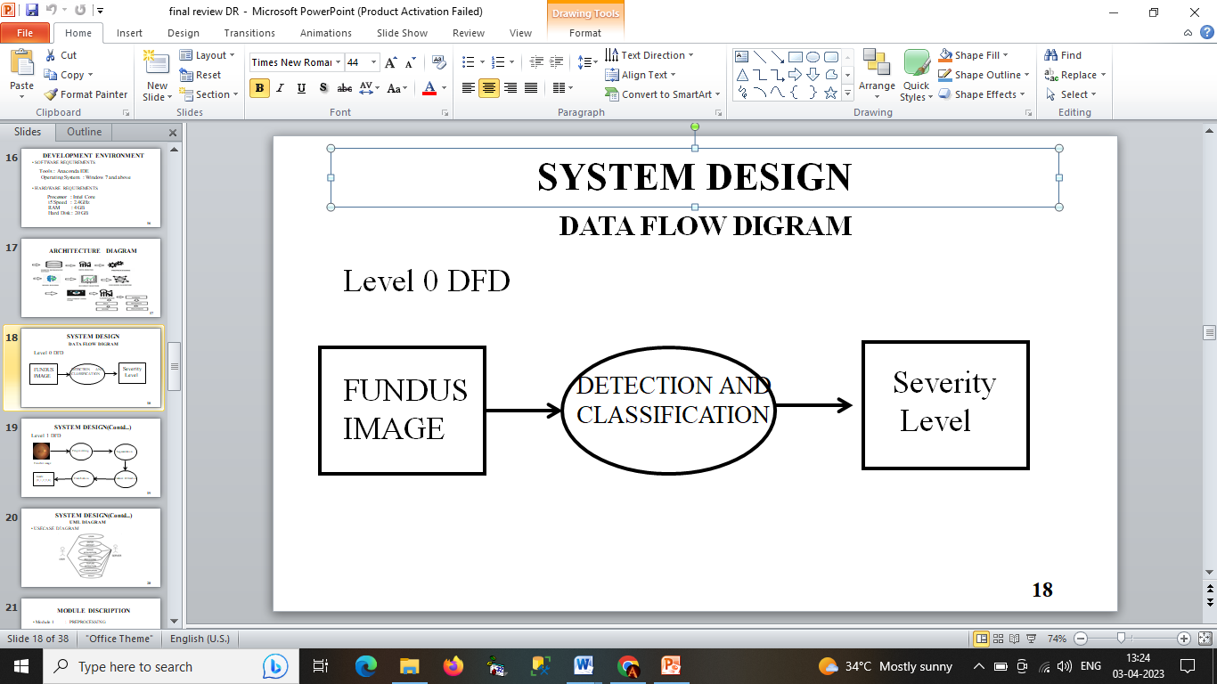
SYSTEM DESIGN
DATA FLOW DIGRAM
LEVEL 0 DFD

Slide 14
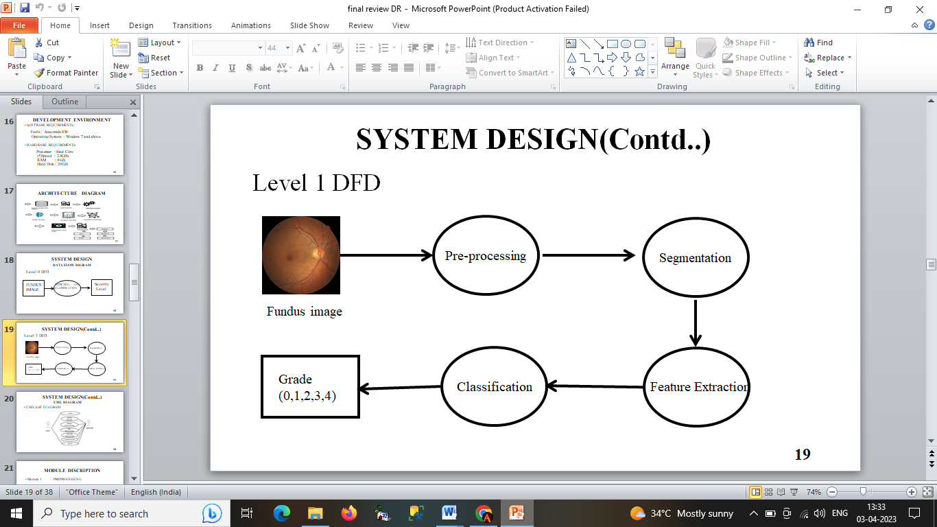
SYSTEM DESIGN
LEVEL 1 DFD

Slide 15
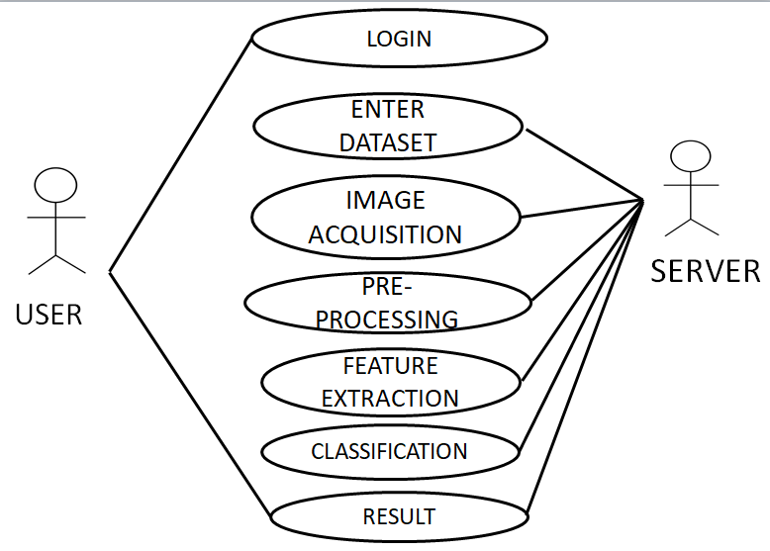
SYSTEM DESIGN
UML DIAGRAM
USE-CASE DIAGRAM

Slide 16
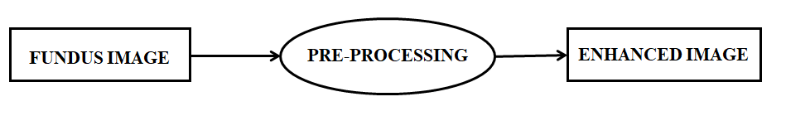
MODULE DESCRIPTION
PREPROCESSING
Preprocessing is a process of preparing the raw data and making it suitable for a machine learning model
Patient movement, poor focus, bad positioning, reflections, inadequate illumination can cause a significant proportion of images to be of such poor quality as to interfere with analysis.
Preprocessing of such images can ensure adequate level of success in the automated abnormality detection

Slide 17
MODULE DESCRIPTION
SEGMENTATION
Involves the partitioning of an image or volume into Involves the partitioning of an image or volume into distinct (usually) non-overlapping regions in a meaningful way.
Identifies separate objects within an image .
Finds regions of connected pixels with similar properties.
Finds boundaries between regions.
Removes unwanted regions

Slide 18
MODULE DESCRIPTION
FEATURE EXTRACTION
Feature extraction refers to the process of transforming raw data into numerical features that can be processed while preserving the information in the original data set.
Feature extraction a type of dimensionality reduction that efficiently represents interesting parts of an image as a compact feature vector.
This approach is useful when image sizes are large and a reduced feature representation is required to quickly complete tasks such as image matching, classification and retrieval

Slide 19
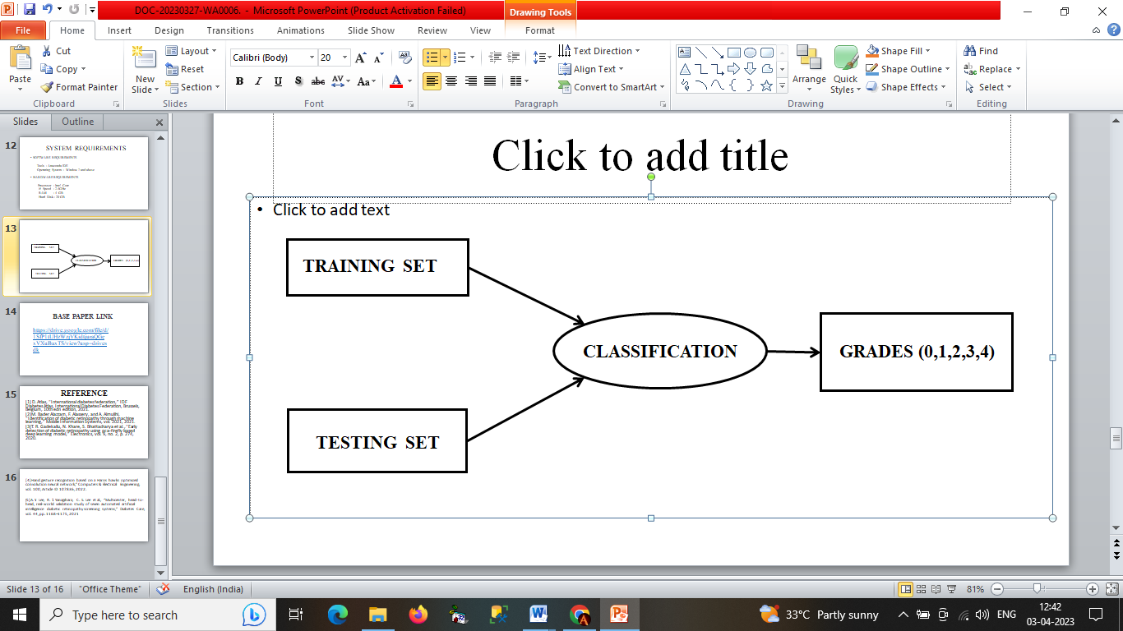
MODULE DESCRIPTION
CLASSIFICATION
Image classification analyzes the numerical properties of various image features and organizes data into categories Classification algorithms typically employ two phases of processing training and testing

Slide 20
EXISTING ALGORITHM
Otsu thresholding algorithm
Otsu thresholding divides image into Foreground and Background Pixels, thus assigning Pixels nearer to the black level as 0 and white level as 1, converting image to binary.
The thresholding identifies minimum variance between these pixels to aptly identify them.
Otsu's thresholding method involves iterating through all the possible threshold values and calculating a measure of spread for the pixel levels each side of the threshold

Slide 21
PROPOSED ALGORITHM
Otsu thresholding algorithm
Otsu thresholding divides image into Foreground and Background Pixels, thus assigning Pixels nearer to the black level as 0 and white level as 1, converting image to binary.
Otsu's thresholding method involves iterating through all the possible threshold values and calculating a measure of spread for the pixel levels each side of the threshold

Slide 22
PROPOSED ALGORITHM
Random Forest algorithm
The Random Forests algorithm is one of the best among classification algorithms - able to classify large amounts of data with accuracy.
Random Forests are a combination of tree predictors where each tree depends on the values of a random vector sampled independently with the same distribution for all trees in the forest.

Slide 23
Testing
TEST CASE
Case name | Best Case
Input | High Quality Image (.png )
Actual Output | Moderate ❌(45% RISK)
Expected Output | Moderate ❌(45% RISK)
Remarks | Pass

Slide 24
RESULTS
The input is given as a Fundus image in user interface
This system classifying the disease in to FIVE STAGES, namely, Normal, Mild, Moderate , Severe and Proliferative .
The risk percentage also displayed with the result.

Slide 25
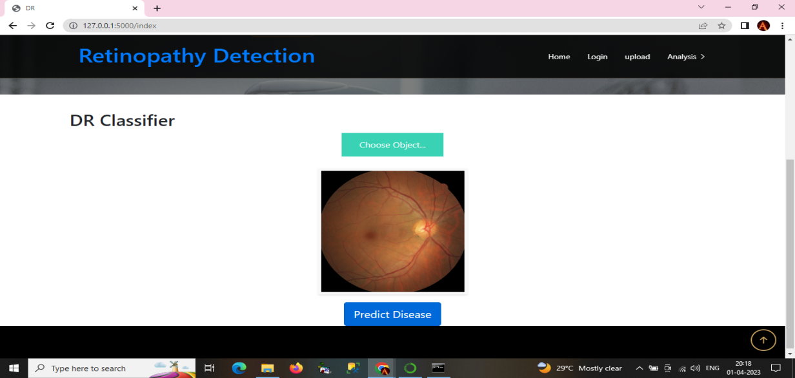
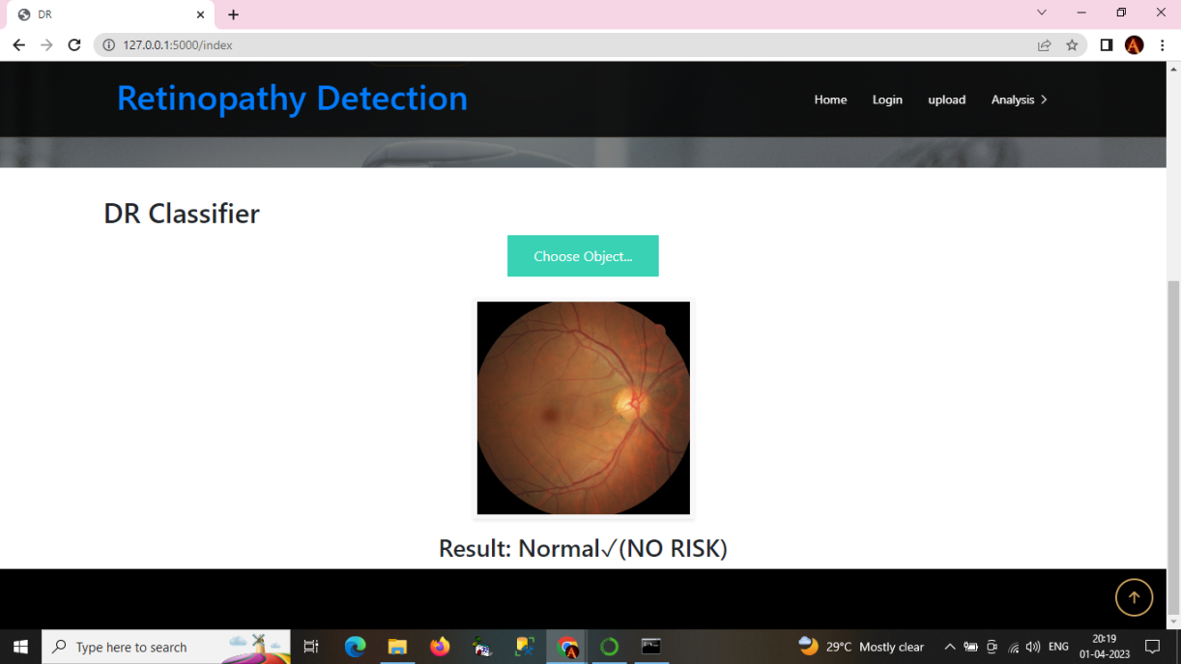
SCREEN SHOTS

Slide 26
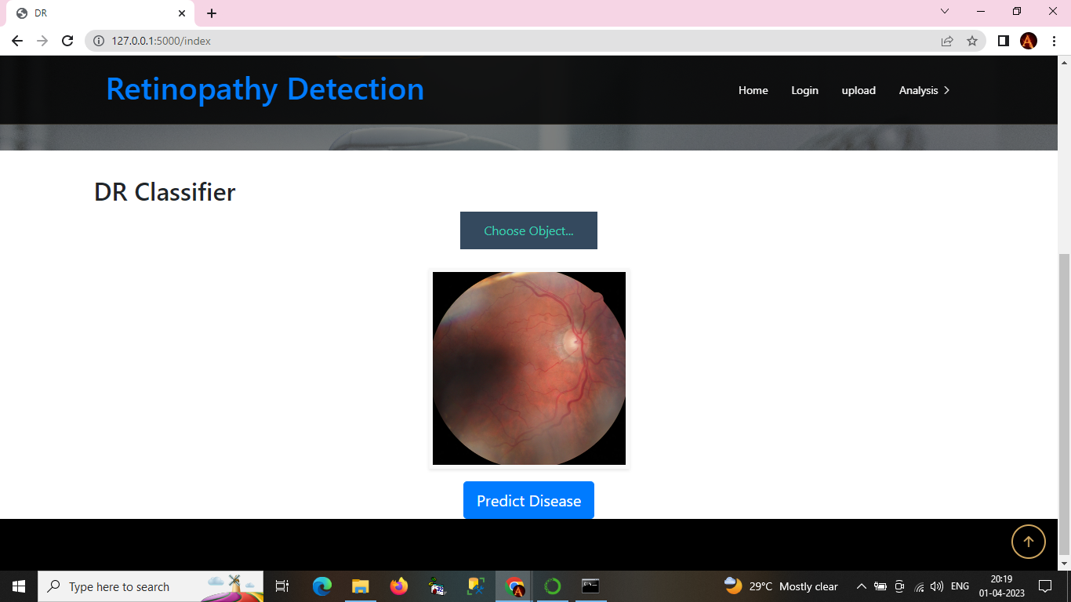
SCREEN SHOTS

Slide 27
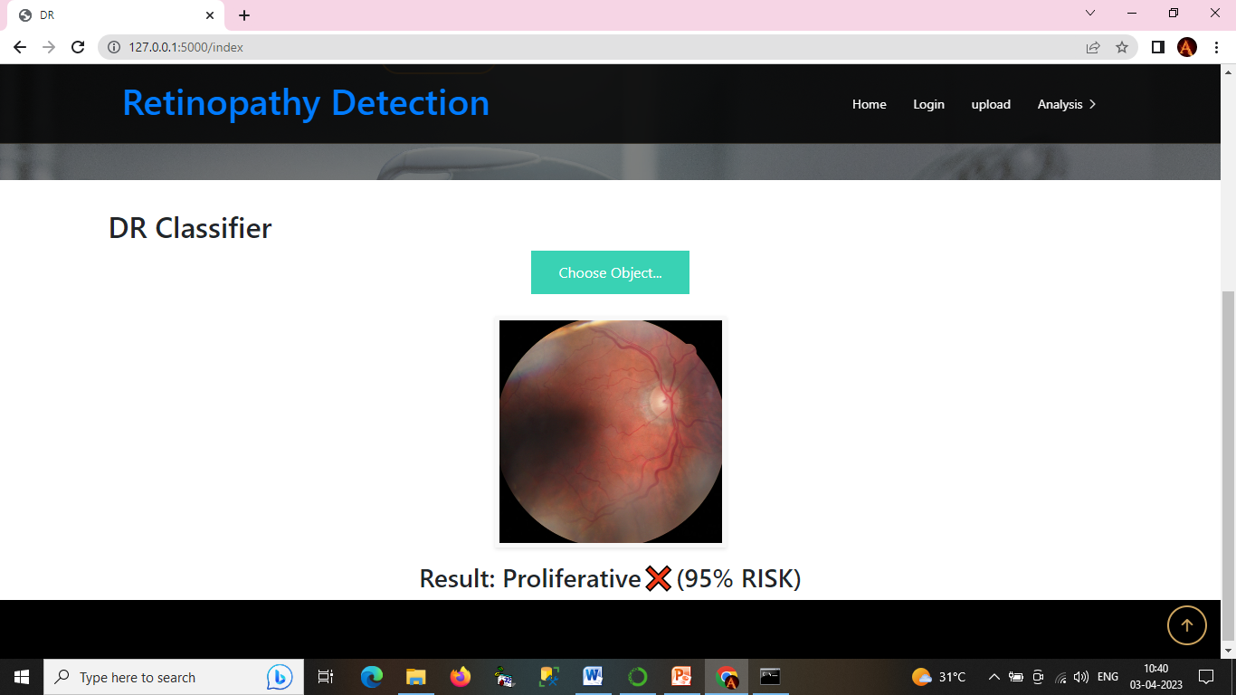
SCREEN SHOTS

Slide 28
CONCLUSION
The fast and efficient early detection of Diabetic Retinopathy is only possible if there is an effective method for segmenting the diabetic features in the fundus image.
The proposed system presents a fast, effective and robust way of detecting diabetic features in the fundus images which can be used for classification of the images based on the severity of the disease.
The retinal images are subjected to gray scale conversion, preprocessing and feature extraction steps and provide the result.

Slide 29
REFERENCE PAPER
[1]Thangam palaniswamy,Mahendrian vellingiri,"Internet of things and deep learning enabled diabetic retinopathy fundus images vol.11,2023
[2] Mohammad Z.Atwany,"Deep learning technique for diabetic
retinopathy"vol:10,publish IEEE,2022
[3]Hamza Mustafa,Syed Farooq Ali,"Multi-stream deep neural network for diabetic retinopathy severity classification under a boosting framework"vol:10,2022
[4]Hand gesture recognition based on a Harris hawks optimized convolution neural network,” Computers & Electrical Engineering, vol. 100, Article ID 107836, 2022.
[5]Jingbottu, Huan Wang, Yelu,"Graph adversarial transfer learning for diabetic retinopathy classification",vol:10,2022
[6]Binhua yang,Tong Yan Li"Classification of diabetic retinopathy severity based on GCA attention mechanism", vol:9,2022

Slide 30
REFERENCE PAPER
[7]A. Y. Lee, R. T. Yanagihara, C. S. Lee et al., “Multicenter, head-to-head, real-world validation study of seven automated artificial intelligence diabetic retinopathy screening systems,” Diabetes Care, vol. 44, pp. 1168–1175, 2021
[8] D.Atlas, “International diabetes federation,” IDF Diabetes Atlas, International Diabetes Federation, Brussels, Belgium, 10th edn edition, 2021.
[9]Meysam tavakoli,Alireza Mehdizadeh ,Tim ellis"Automated
microaneursysms detection in retinal images using radon transform and supervised learning application to mass screening of diabetic
retinopathy",vol:9,2021
[10]Md Nahiduzzaman,Md.robiul Islam"Hybrid CNN-SVD based prominent features extraction and selection for grading diabetic retinopathy using extreme learning machine",vol:9,2021

